Slide 1
Representation and Description
Ashis Pradhan
(CSE Department, SMIT)

Slide 2
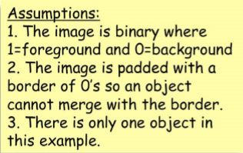
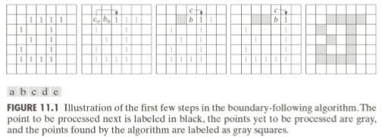
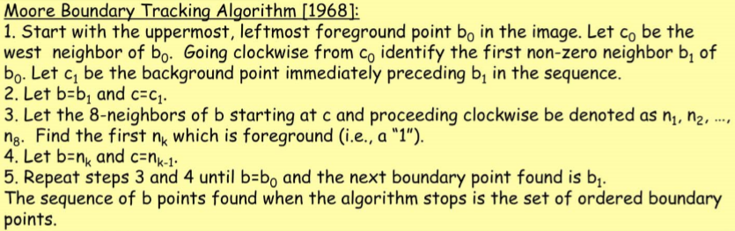
Border (Boundary) Following Algorithm
Gonzalez & R. E. Woods

Slide 3
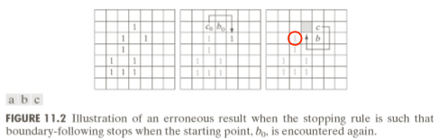
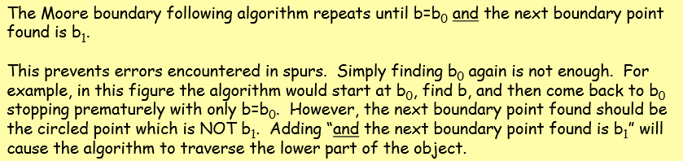
Border (Boundary) Following Algorithm
Gonzalez & R. E. Woods

Slide 4
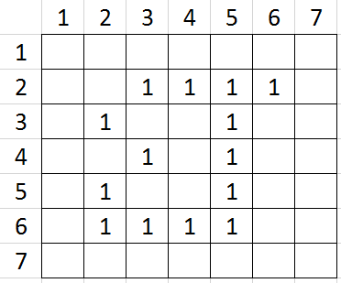
BORDER FOLLOWING ALGORITHM
Stop on Reaching Starting Pixel
= Background Pixel
= Current Pixel
= Traversed Pixel

Slide 5
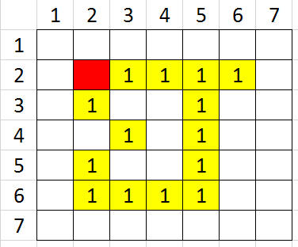
BORDER FOLLOWING ALGORITHM
= Background Pixel
= Current Pixel
= Traversed Pixel

Slide 6
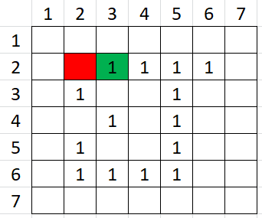
BORDER FOLLOWING ALGORITHM
= Background Pixel
= Current Pixel
= Traversed Pixel

Slide 7
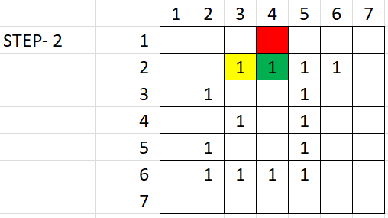
BORDER FOLLOWING ALGORITHM
= Background Pixel
= Current Pixel
= Traversed Pixel

Slide 8
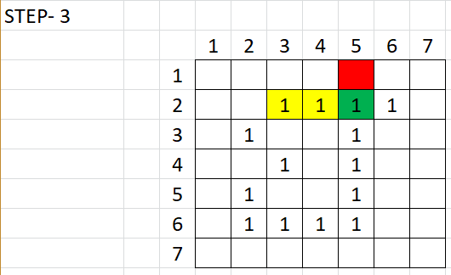
BORDER FOLLOWING ALGORITHM
= Background Pixel
= Current Pixel
= Traversed Pixel

Slide 9
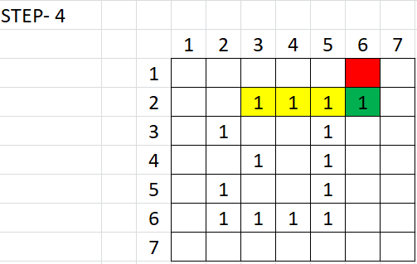
BORDER FOLLOWING ALGORITHM
= Background Pixel
= Current Pixel
= Traversed Pixel

Slide 10
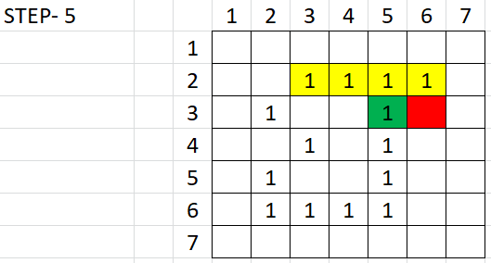
BORDER FOLLOWING ALGORITHM
= Background Pixel
= Current Pixel
= Traversed Pixel

Slide 11
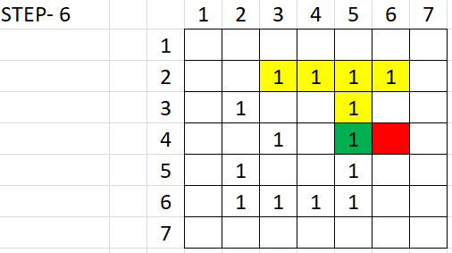
BORDER FOLLOWING ALGORITHM
= Background Pixel
= Current Pixel
= Traversed Pixel

Slide 12
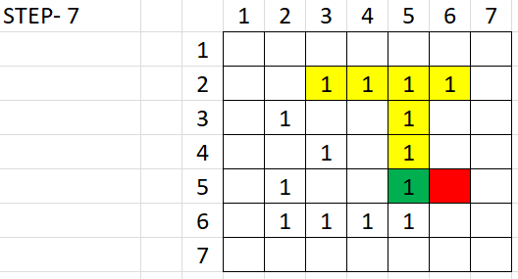
BORDER FOLLOWING ALGORITHM
= Background Pixel
= Current Pixel
= Traversed Pixel

Slide 13
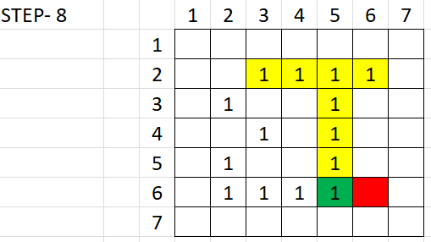
BORDER FOLLOWING ALGORITHM
= Background Pixel
= Current Pixel
= Traversed Pixel

Slide 14
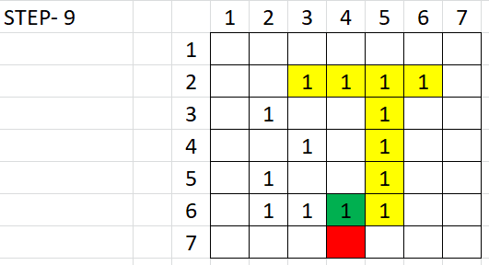
BORDER FOLLOWING ALGORITHM
= Background Pixel
= Current Pixel
= Traversed Pixel

Slide 15
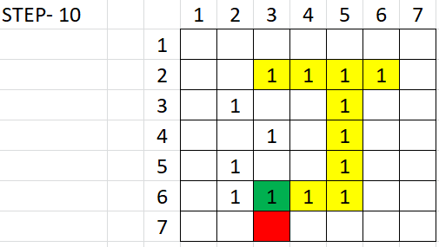
BORDER FOLLOWING ALGORITHM
= Background Pixel
= Current Pixel
= Traversed Pixel

Slide 16
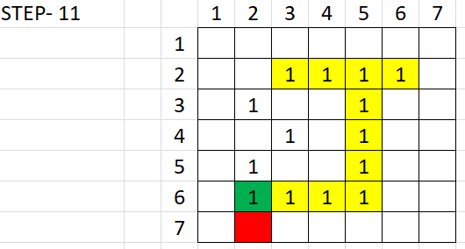
BORDER FOLLOWING ALGORITHM
= Background Pixel
= Current Pixel
= Traversed Pixel

Slide 17
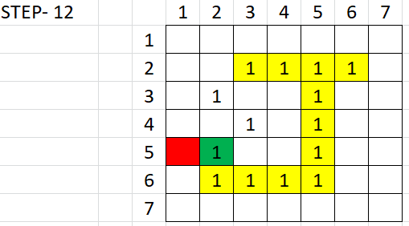
BORDER FOLLOWING ALGORITHM
= Background Pixel
= Current Pixel
= Traversed Pixel

Slide 18
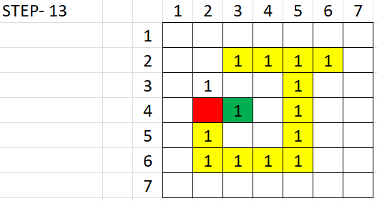
BORDER FOLLOWING ALGORITHM
= Background Pixel
= Current Pixel
= Traversed Pixel

Slide 19
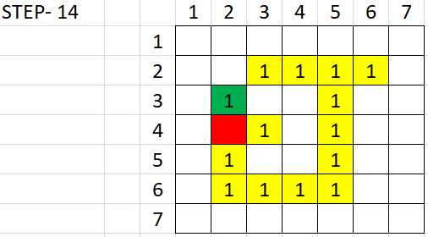
BORDER FOLLOWING ALGORITHM
= Background Pixel
= Current Pixel
= Traversed Pixel

Slide 20
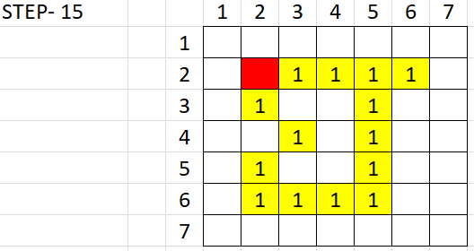
BORDER FOLLOWING ALGORITHM
= Background Pixel
= Current Pixel
= Traversed Pixel

Slide 21
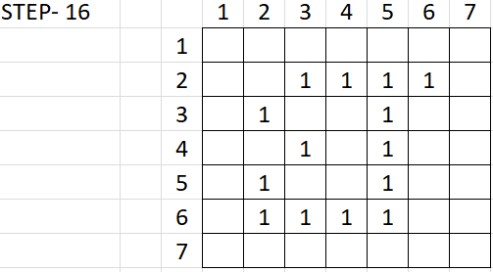
BORDER FOLLOWING ALGORITHM
= Background Pixel
= Current Pixel
= Traversed Pixel

Slide 22
Chain Codes
Chain code are used to represent a boundary by connected sequence of straight line segment of specified length and direction.
This representation is based on 4 or 8- Connectivity.
A boundary formed as a sequence of such directional numbers is called as Freeman chain Code.
method is generally unacceptable for 2 reason:
The resulting chain is quite long
Any small disturbances in boundary due to noise or imperfect segmentation may lead to changes in chain code.
To avoid such problem: Resample the boundary by selecting larger grid spacing.
The chain code of boundary depends on the starting point.

Slide 23
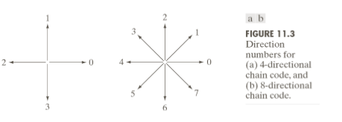

Chain Codes
Gonzalez & R. E. Woods

Slide 24
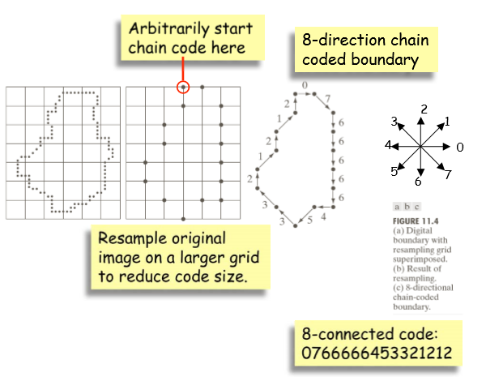
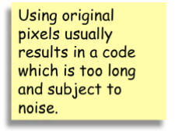
Chain Codes
Note: The accuracy of the resulting code representation depends on the spacing of the sampling grid.
Gonzalez & R. E. Woods

Slide 25
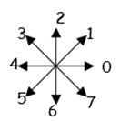
Problems with Chain Code
Starting point
Rotation:
Normalization for size:
Starting Point
0 7 5 4 3 1
7 5 4 3 1 0
4 1 7
0 5 3

Slide 26
Solution to problems
Normalization for starting point: Treat the code as a circular sequence and redefine the starting point s that the resulting sequence of numbers forms an integer of minimum magnitude.
Normalization for rotation: Use the first difference of the chain code instead of the code itself. The difference is simply by counting (counter-clockwise) the number of directions that separate two adjacent elements of the code.
Example: The first difference of the 4-direction chain code 10103322 is 33133030.
Normalization for size: Alter the size of the resampling grid.

Slide 27
Solution to Problem
Starting point
Rotation:
Normalization for size:
Starting Point
0 7 5 4 3 1
7 5 4 3 1 0
0 7 5 4 3 1
4 1 7
5 6 5
0 5 3
5 6 5

Slide 28
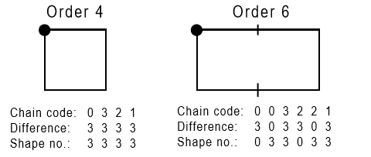
Boundary descriptors
Shape numbers: Shape number of a boundary is defined as the first difference of a chain code of the smallest magnitude.
The order n of a shape number is the number of digits in its representation.
The following figures shows all shapes of order 4 and 6 in a 4-directional chain code:

Slide 29
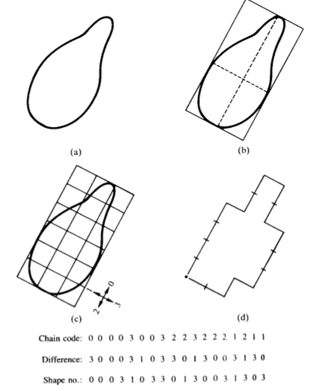
Steps for generating Shape Number
Note that the first difference is calculated by treating the chain codes as a circular sequence.

Slide 30
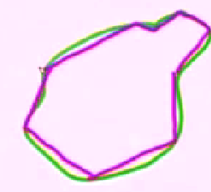
Polygon Approximation

Slide 31
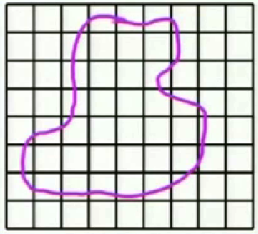
A. Minimum Perimeter Polygon

Slide 32
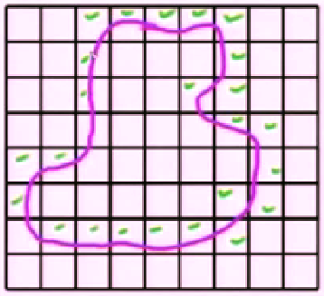
A. Minimum Perimeter Polygon

Slide 33
A. Minimum Perimeter Polygon
Allow both line to contract and get new polygon.

Slide 34
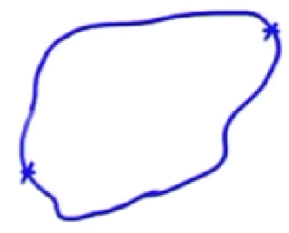
B. Boundary Splitting Technique

Slide 35
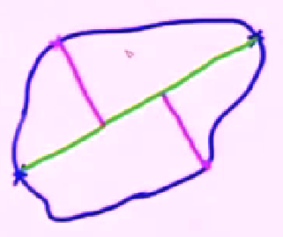
B. Boundary Splitting Technique

Slide 36
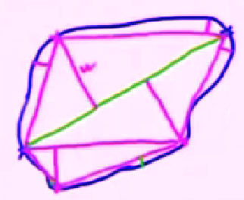
B. Boundary Splitting Technique

Slide 37
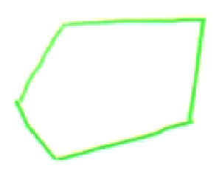
B. Boundary Splitting Technique

Slide 38
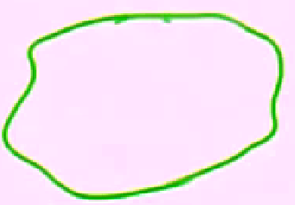
Other Splitting Technique

Slide 39
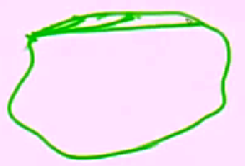
Other Splitting Technique

Slide 40
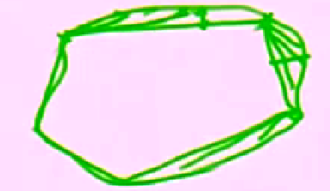
Other Splitting Technique

Slide 41
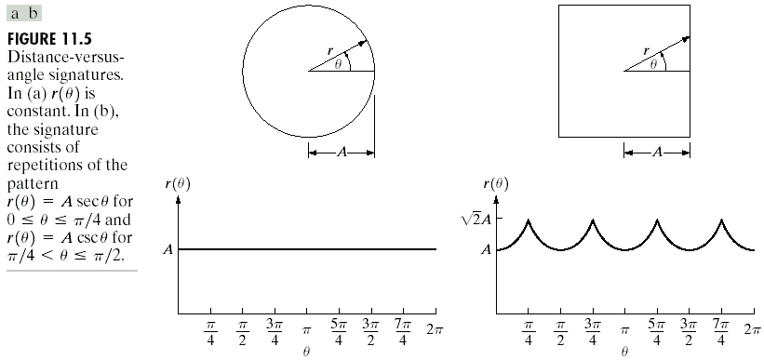
Signatures: It is the 1-D mapping of a closed boundary
To generate: Plot the distance from the centroid to the boundary as a function of angle.

Slide 42
Boundary Descriptors
Length:
Number of pixels
Number of vertical and horizontal components + √2 times the number of diagonal components
Diameter:
D: distance measure; p_{i},p_{j}: boundary points
Major axis (connecting the two extreme points)

Slide 43
Boundary Descriptors
Curvature:
Rate of change of slope
i.e. using the difference between the slopes of adjacent boundary segments, which have been represented as straight lines, as a descriptor of curvature at the point of intersection of the segments.
Other Boundary Descriptors: Shape numbers, Fourier descriptors, Moments.

Slide 44
Regional Descriptors
Area: No. of pixels within the boundary
Perimeter: length of boundary
Can be used with area to measure compactness (perimeter²/area)
Compactness is:
Dimensionless, and thus insensitive to scale changes
Insensitive to orientation

Slide 45
Regional Descriptors
Principal axes:
Eigenvectors of the covariance matrix
Ratio of large to small eigenvalue: insensitive to scale and rotation
Other descriptors:
Mean and median of gray levels
Min. and max. gray-level values
No. of pixels with values above and below the mean

Slide 46
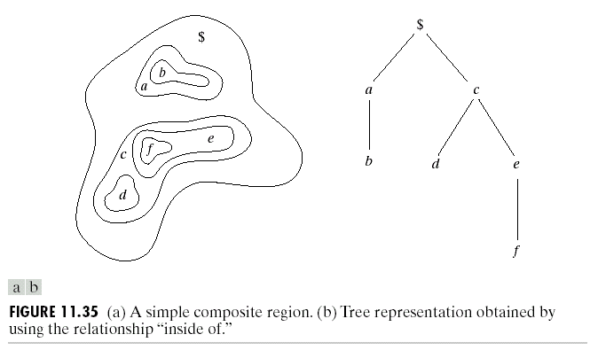
Example

